Slide 1






Web Services and Cloud
Web Services & Cloud Course Program, Evaluation, Exams
Web Services & Cloud
SoftUni Team
Technical Trainers
Software University
http://softuni.bg

Slide 2
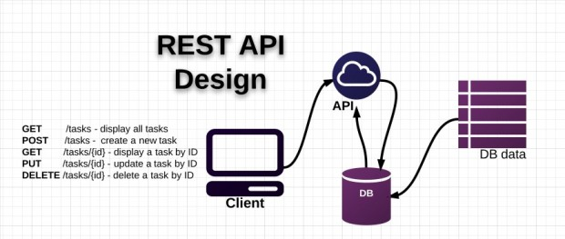


Table of Contents
Course Objectives
Course Program
Trainers Team
Examination
Learning Resources

Slide 3









SoftUni Diamond Partners

Slide 4

SoftUni: Levels, Modules, Schedule
Programming Basics
2 months
6 credits
Programming Fundamentals
36 credits
6 months
Advanced C#
Object-Oriented Programming
High-Quality Code
Java Basics
Teamwork and Personal Skills
Web Front-End
Back-End
36 credits
36 credits
HTML + CSS + WordPress
JavaScript Basics
Advanced JavaScript
Databases
Database Applications
Web Services and Cloud
6 months
JavaScript Applications
JavaScript Frameworks
PHP Web Development
ASP.NET MVC Web Development

Slide 5

Web Services and Cloud
Course Objectives & Program

Slide 6
Course Program
Course Introduction
Web Services Overview – SOA, SOAP, WSDL, REST, …
ASP.NET Web API – REST Services with C# and .NET
OOP Basic Topics
OOP Principles – Inheritance, Polymorphism, etc.
ASP.NET Web API – Workshop
Asynchronous Web Services

Slide 7


Course Program (2)
Consuming REST Services with C#
Unit Testing Basics and Mocking
Unit and Integration Tests for Web Services
Cloud Technologies and Platforms
Lab – Creating REST API
Exam Preparation
Deployment of REST Services in Cloud (Azure)

Slide 8

Course Program (3)
Amazon Web Services for C# Developers
Teamwork Defense
Practical Exam

Slide 9

The Trainers Team

Slide 10
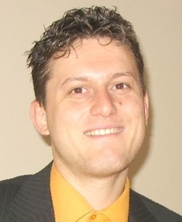
Trainers Team
Svetlin Nakov, PhD
Training & Inspiration Manager @ Software University
20+ years software development experience
10+ years experience as trainer
Author of 7 programming books
Winner in International programming contests and Olympiads
Speaker at hundreds of events
Web site & blog: www.nakov.com

Slide 11


Trainers Team
Atanas Rusenov
Technical Trainer @ Software University
Top performing student from the Software University (2014)
Nikolay Bankin
Software Engineer at Obecto
Top performing student from the Software University (2014)

Slide 12

Web Services and Cloud: More Details
Duration, Languages, Technologies

Slide 13


Training Duration – Web Services and Cloud
Lectures: ~ 16 hours (onsite + YouTube videos)
Practical exercises (in class): ~ 20 hours
Homework: ~ 40-50 hours
Teamwork project: ~ 10-20 hours
Schedule: August-September 2015
Practical exam: 12 September 2015

Slide 14



Why English?
Why the slides are in English?
English is the native language of the software engineers
Specific terminology should be in English
Translations are inaccurate and funny
Just learn English!
No excuses

Slide 15



Web Services and Cloud
Evaluation Criteria

Slide 16

Scoring System for the "WS and Cloud"
Practical Exam – 80%
Teamwork Project – 10%
Homework + Evaluation – 5% + 5%
Presence in class: 5% (onsite students only)
Bonuses: up to 10%

Slide 17

The Practical Exam
Web Services & Cloud Practical Exam
Design a RESTful web service with ASP.NET Web API
You will be given a description of the service endpoints
You will need to implement the web services
You will need to write tests
Unit tests and integration tests
Your services will be evaluated against all possible scenarios

Slide 18

Homework Assignments
Doing your homework is very important!
Programming can only be learned through a lot of practice!
You should write code every day!
Each lecture is followed by a few exercises
Try to solve them in class
The rest are your homework
Homework assignments are due in 1 week after each lesson
Submission will be accepted through our web site: softuni.bg

Slide 19

Homework Peer Reviews
Give feedback to a few random homework submissions
Students submit homework anonymously
Please exclude your name from the submissions!
For each homework submitted
Students evaluate 3 random homeworks
From the same topic, after the deadline
Give written feedback, at least 200 characters
Low-quality feedback → report for punishment
Everyone will get feedback for their homework

Slide 20








Resources
What We Need Additionally?

Slide 21

Course Web Site & Forums
The WS & Cloud official web site:
Register for the "Software University Forum":
Discuss the course exercises with your colleagues
Find solutions for all course exercises
Share source code / discuss ideas / help each other
https://softuni.bg/trainings/1191/Web-Services-and-Cloud-Aug-2015
https://softuni.bg/forum

Slide 22



Web Services & Cloud Slides and Videos
All lecture slides, videos, homework assignments, projects and other resources are open content, available for free
Visit the course web site to access the course resources

Slide 23
Web Services and Cloud – Additional Resources
ASP.NET Web API Official Tutorials
http://www.asp.net/web-api
Build RESTful API's with ASP.NET Web API
http://www.asp.net/web-api/overview/older-versions/build-restful-apis-with-aspnet-web-api

Slide 24
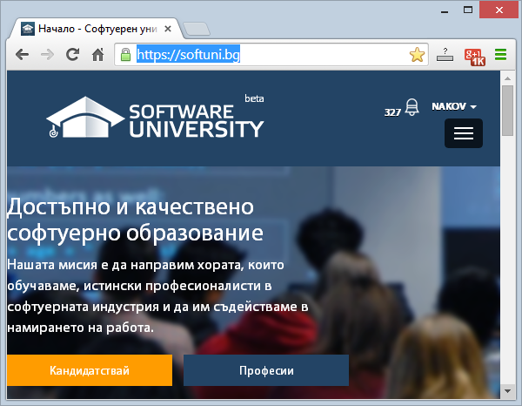
Software University Learning System (SULS)
Software University Learning System (SULS)
www.softuni.bg
Important resource for students
Homework submissions
Homework check-up
Exams and results
Reports about your progress
…

Slide 25
Recommended Software
Visual Studio Community 2013
Visual Studio 2015 may work as well
Microsoft SQL Server 2014 (Express or Standard Edition) + SQL Server Management Studio 2014
SQL Server 2012 may work as well
Postman REST Client
Azure Tools for Microsoft Visual Studio

Slide 26




Web Services & Cloud – Course Introduction
https://softuni.bg/courses/web-services-and-cloud/

Slide 27
License
This course (slides, examples, demos, videos, homework, etc.) is licensed under the "Creative Commons Attribution-NonCommercial-ShareAlike 4.0 International" license
Attribution: this work may contain portions from
"Web Services and Cloud" course by Telerik Academy under CC-BY-NC-SA license

Slide 28






Free Trainings @ Software University
Software University Foundation – softuni.org
Software University – High-Quality Education, Profession and Job for Software Developers
softuni.bg
Software University @ Facebook
facebook.com/SoftwareUniversity
Software University @ YouTube
youtube.com/SoftwareUniversity
Software University Forums – forum.softuni.bg

